Slide 1
Pocket Pelvis
EML-HIVE UBC

Slide 2
Our presentation
Who Are We?
Problem
Solution
3D Modeling Process
Unity
Why 3D Printed?
Student Feedback
Future Direction

Slide 3
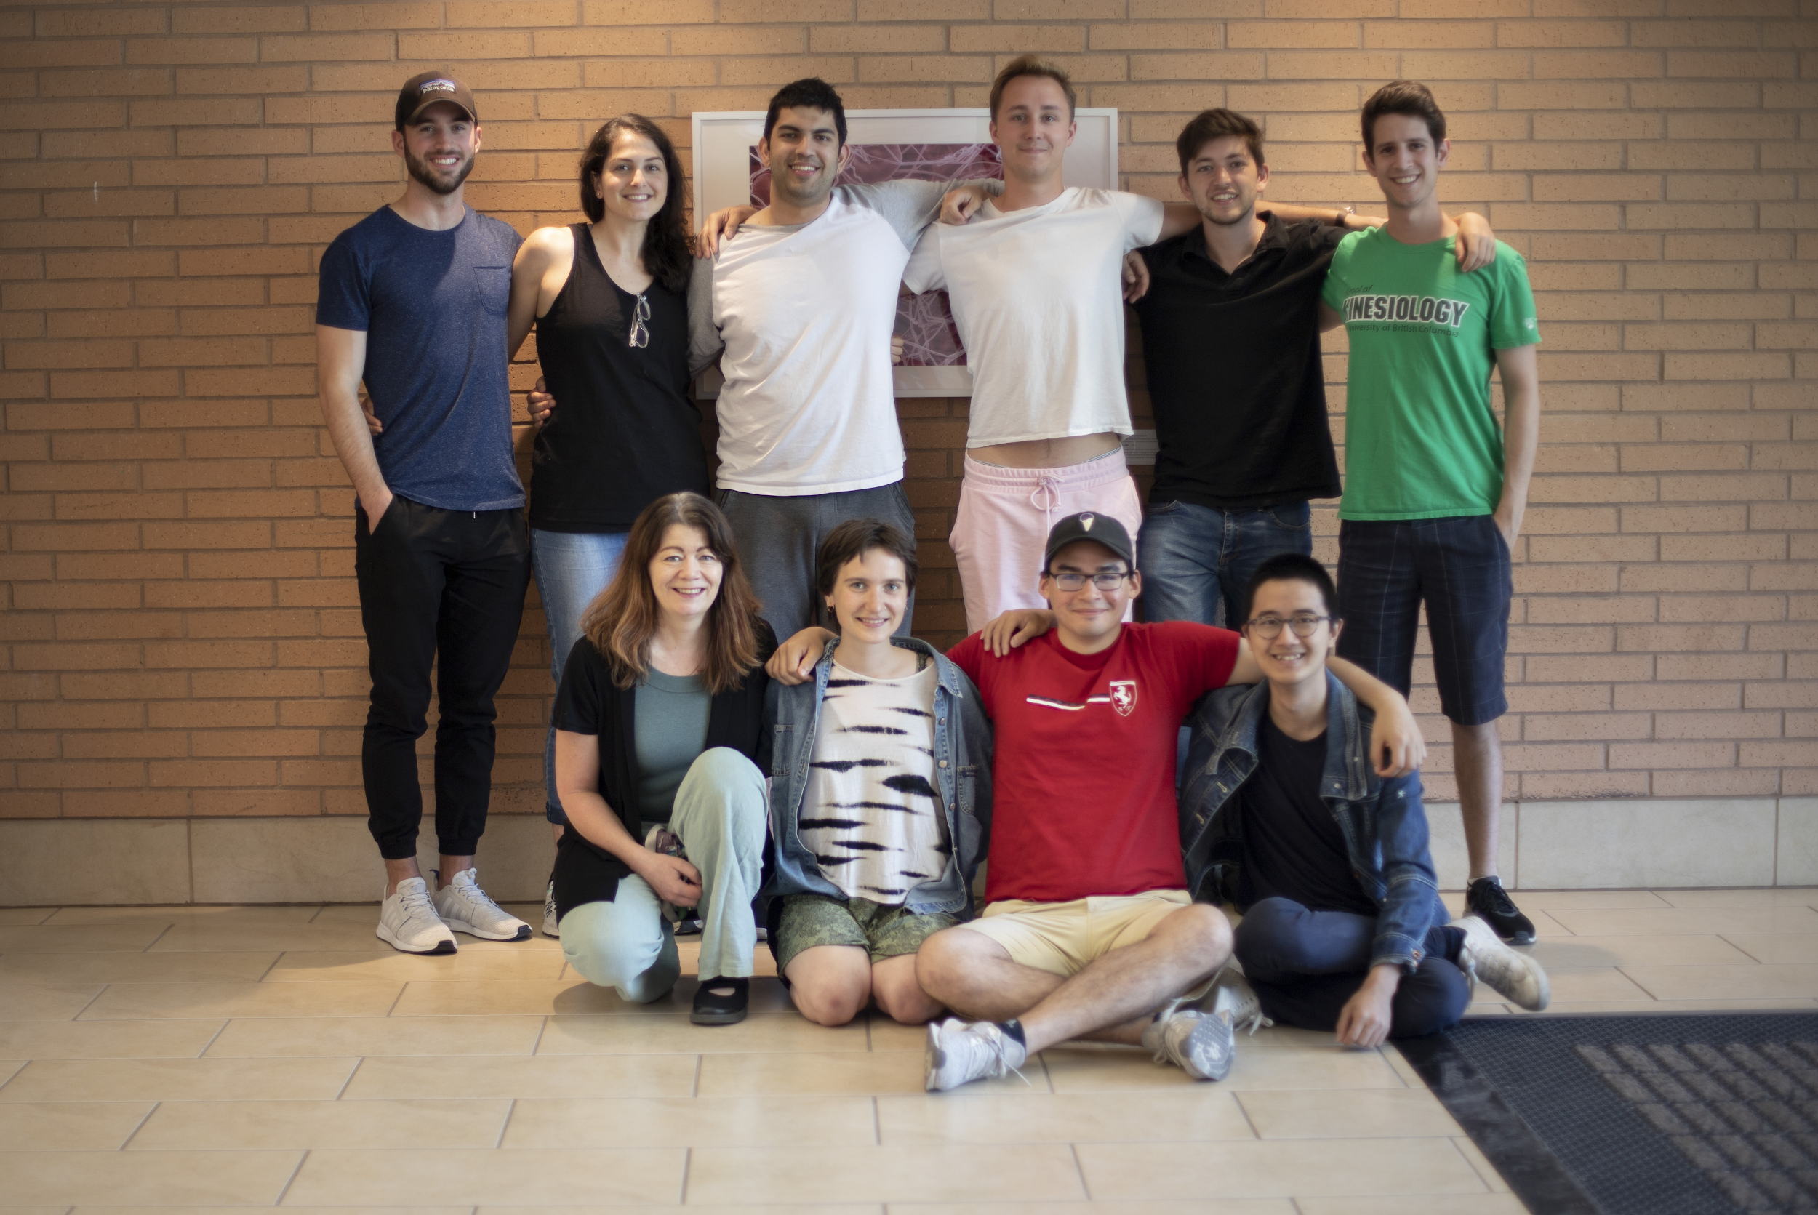
Who are we?
Notes:
Hackspace for Innovation and Visualization in Education (HIVE) is a lab at UBC with a focus on creating educational content using cutting-edge technologies. Our past projects include interactive modules and Holobrain, as well as the Pocket Pelvis, which we will be talking about today.

Slide 4
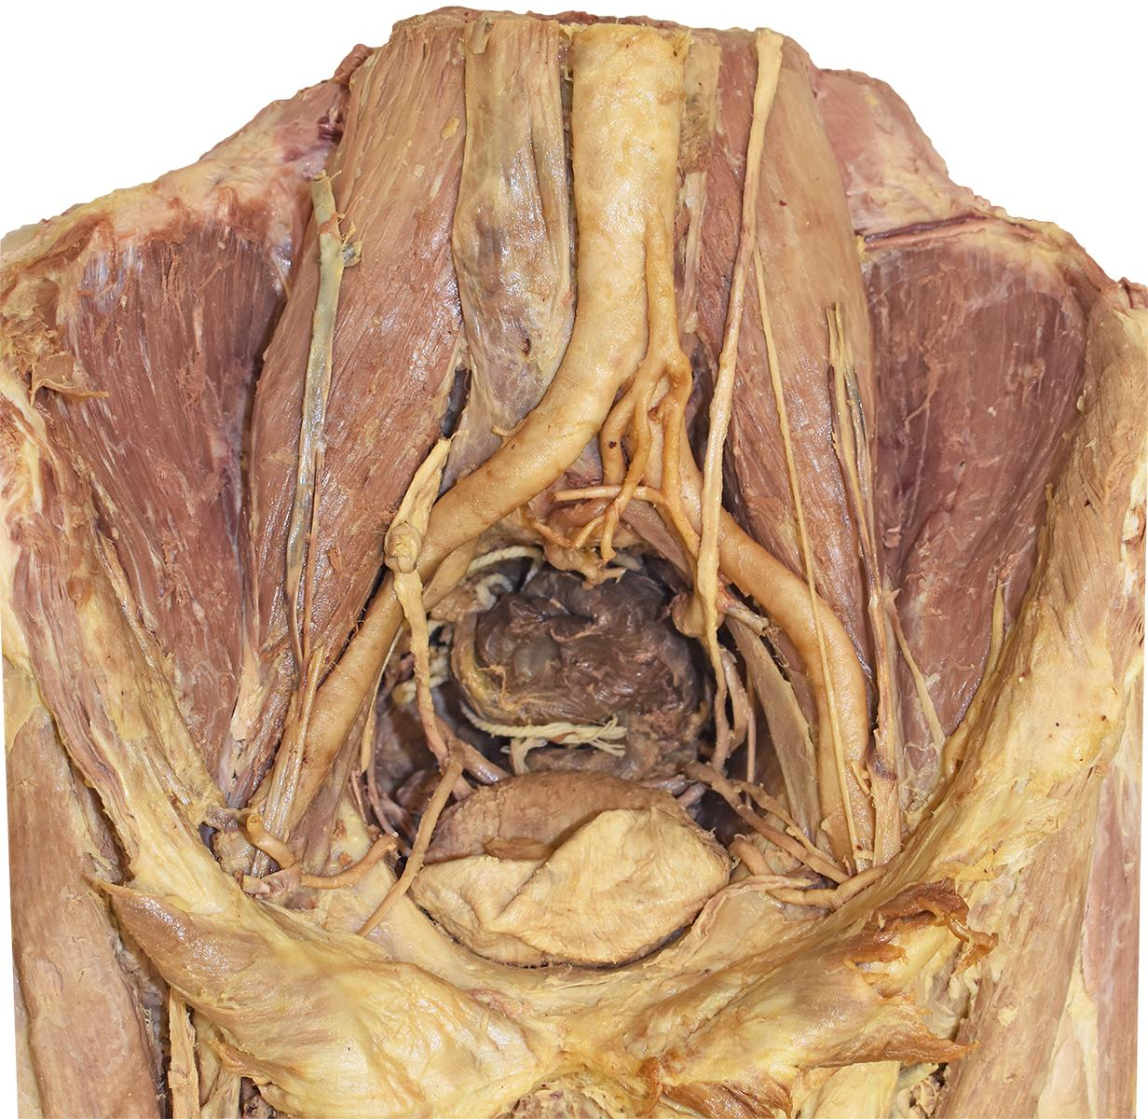
Problem
Anatomical complexity
Notes:
Due to the complexity of the muscles and surrounding structures within the pelvis, students studying pelvic anatomy often struggle with learning the material.

Slide 5
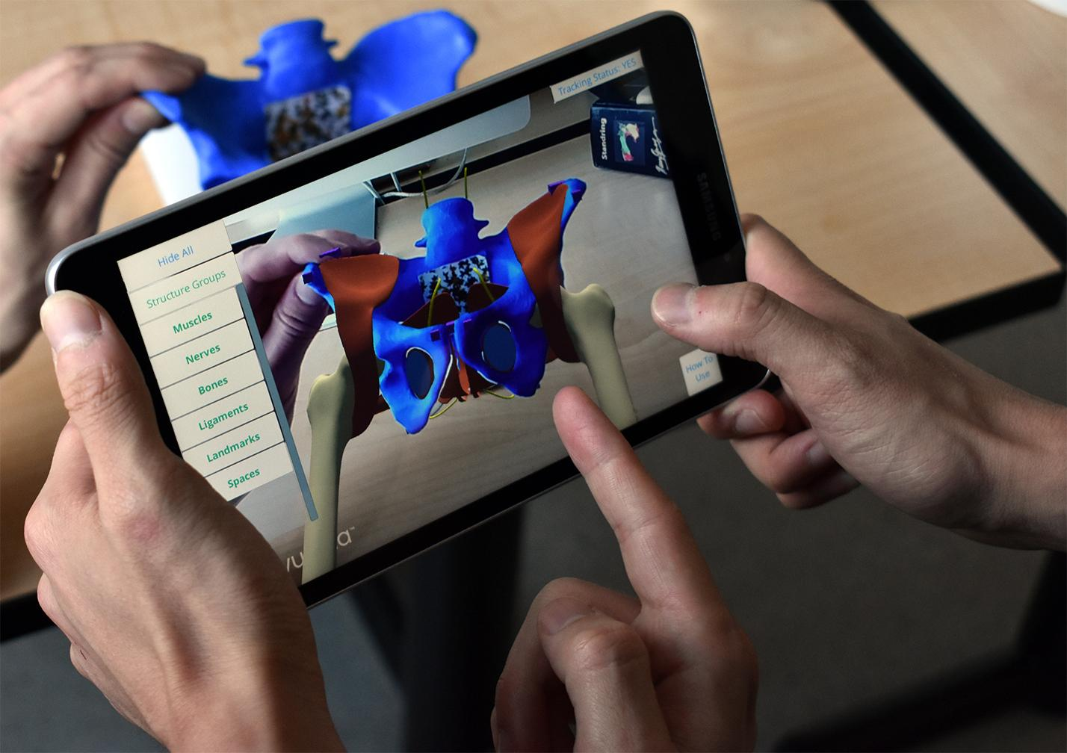
Solution
3D modeled pelvic structures
Unity app with Image Tracking
3D printed pelvis
Notes:
3D printed pelvis that uses image tracking and model recognition to display a superimposed AR pelvis for an interactive learning experience.

Slide 6
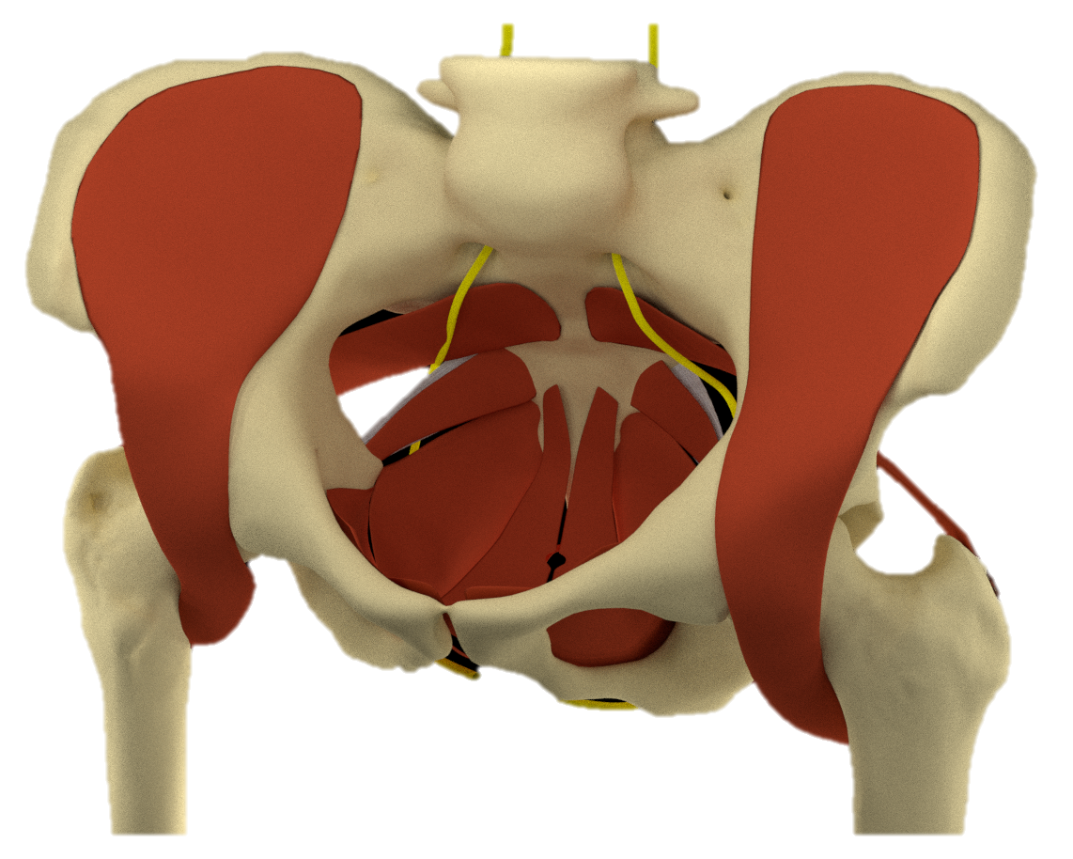
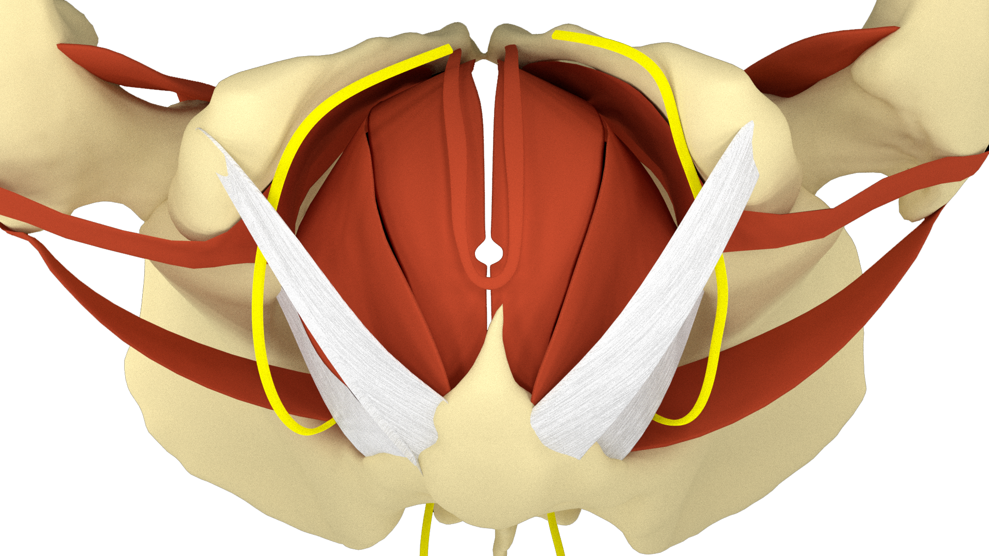
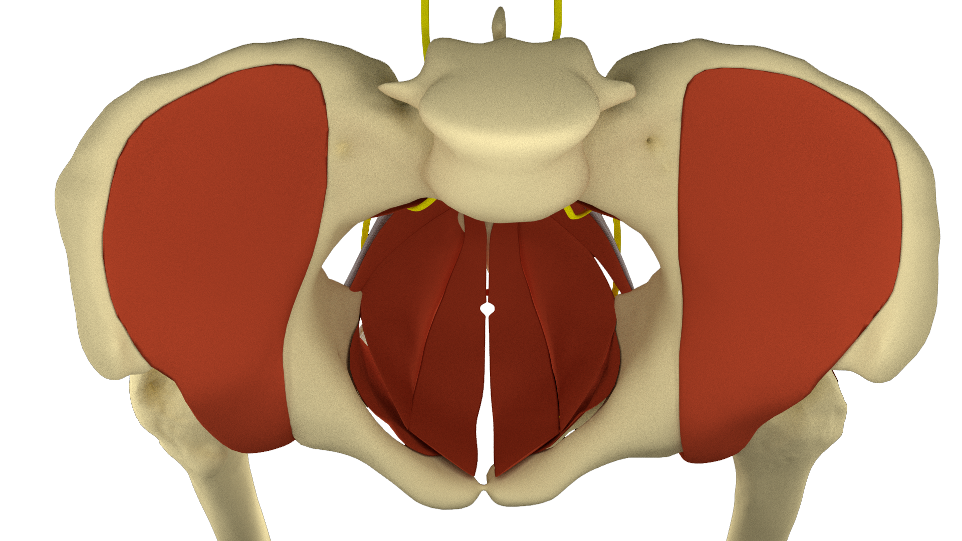
3D Modeling Process
Notes:
Using Blender, we modelled these structures by hand and used extensive anatomical references to ensure accuracy. The challenges that we faced were mostly the translation of 2D references (such as textbooks and images) into 3D models. Having a CT scanned pelvis bone model was an excellent starting point because it gave us an anatomically accurate base to start modelling structures on.

Slide 7
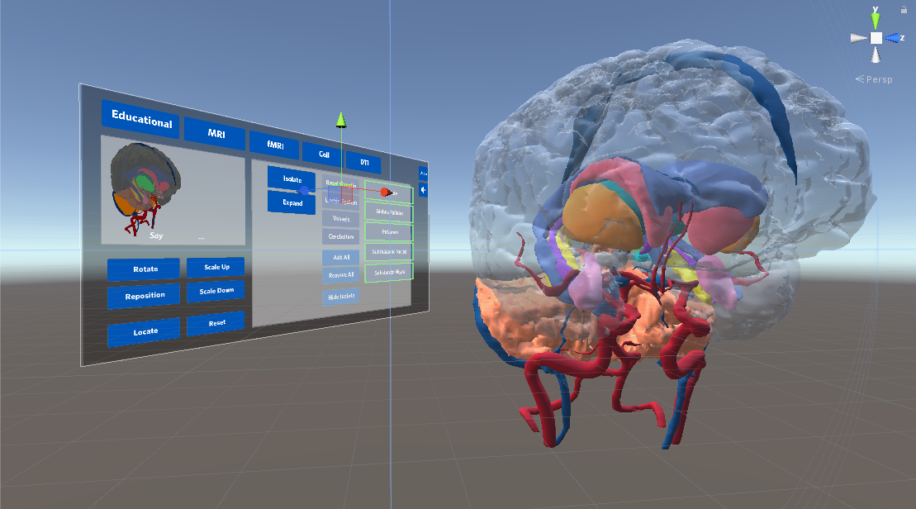
Unity
Notes:
1. (Most people will know this) Unity has great tools and API's for AR dev. Vuforia, HoloToolkit. Combining these tools together you have a lot of functionality at your fingertips.
2. The premade assets can be a bit hard to work with, thankfully unity gives you access to the components that make up these assets to mix and match to get exactly the feel you want
2a) being able to control the feel is very important, especially when the device is head-mounted, or has the window style the Pocket Pelvis has.
3) The nice part about making projects in unity is that you can output to multiple platforms, and are given the tools to tweak your experiences based on the details of the device.
Api + dev tools
Beginner friendly
Make out asset, control feel
Multiple platform

Slide 8
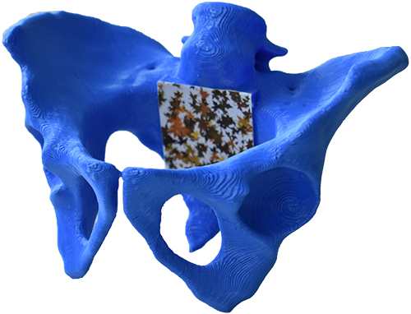
Why 3D Printed?
Notes:
The haptic sensation and the ability to freely rotate the pelvis allows for quicker exploration of the content, which makes learning and manipulating the anatomy of the pelvis easier than on a purely digital interface.

Slide 9
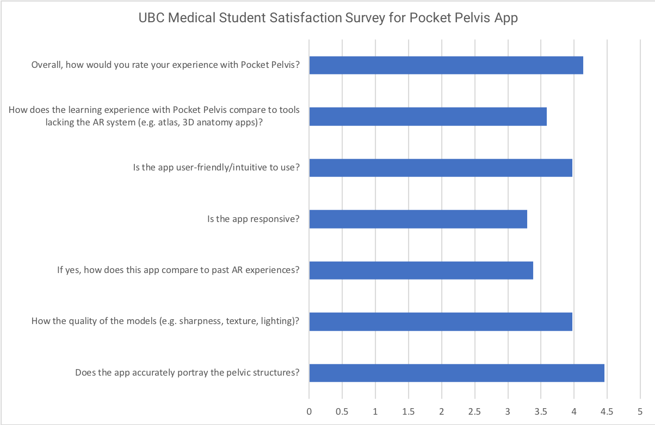
Student Feedback
Mean rating out of 5
Notes:
Overall ⅘. Compares well with other learning tools. Model quality and accuracy were of note, while we have since improved app responsiveness.

Slide 10
Future Direction
Further pelvic structures to add:
Reproductive System
Urinary System
Excretory System
Nervous System
Refactor app for other body parts

Slide 11
Thank you!
Questions?

